Slide 1
THE SILENCE CAMPAIGN
Carolina Gómez, 2017

Slide 2
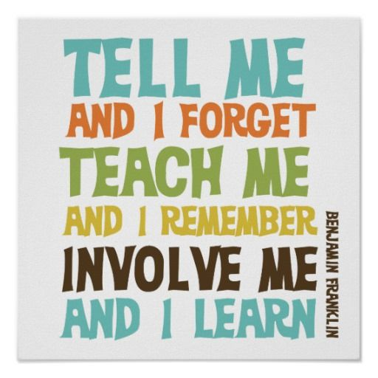

Slide 4
Order and silence in class…
…are the key elements of a successful lesson.
You come to school to learn.
You need to be responsible for your own learning.
Because this is important for YOU.
You are expected to behave well.
A part of behaving well is being quiet during lessons.

Slide 5
Silence

Slide 6
There is always a consequence…
…for bad behaviour.
As we all know, silence is essential for learning.
Silence is the most effective background for learning.
Your parents wouldn’t like to know you’re talking and not paying attention in class, your behaviour is a reflection of your home education.

Slide 8
…Make your parents proud!
Don’t work on other subjects during lessons, that will make you talk and keep you distracted.
Whenever your classmates are talking, they’re stealing from you the right to Education.
Education is your past, your present and your future.
You can’t go without it.

Slide 10
SILENCE IMPROVES…
Classroom atmosphere
Learning
Life at school…
We need to be responsible for our own learning, which includes bringing the materials to school every day.
Teachers will have MORE TIME for you if they don’t need to keep you quiet all the time.

Slide 12
ACTION SPEAKS LOUDER THAN WORDS

Slide 13
If you want to have more freedom of action, you need to be trusted, and if you want to be trusted, you need to be more trustworthy.
Silent learners acquire «inner criteria».
Silent students become more independent.

Slide 14
Being quiet makes listening easier

Slide 15
Remember!
Silence is Essential for Learning!

Slide 16
We need the…
"Sound of Silence" at Work:
Noise makes us feel anxiety, uneasiness, even fear, and negative feelings in general.

Slide 18
Why silence is good for your brain
Here are scientific reasons for how silence benefits your brain and body:
Silence Relieves Stress And Tension
Silence Restores Our Mental Resources
Getting Quiet Can Regenerate Brain Cells

Slide 20
Why silence is good for your body
Silence Improves Memory
Silence Stimulates Brain Growth
We Repeat: Silence Relieves Stress
Silence Fights Insomnia

Slide 21
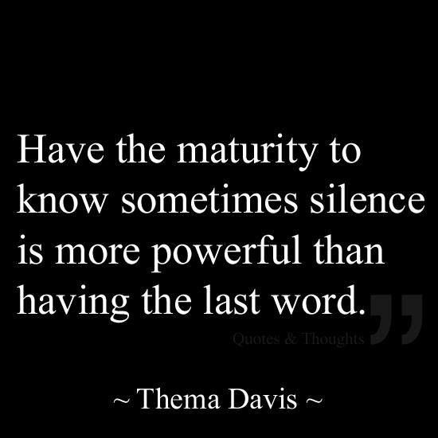

Slide 22
We’re NOT saying “Don’t talk”
We’re saying to stay silent during the lessons. You can talk while teachers are not in the classroom, but once the lesson starts, we ALL need you to stay quiet.

Slide 23
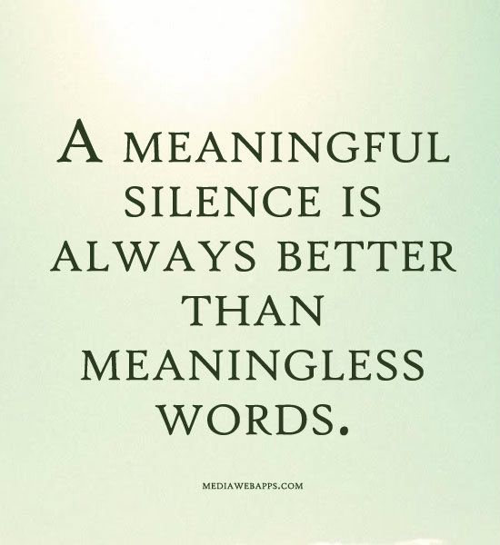
Besides!!

Slide 29
Don’t forget
Don’t work on other subjects during lessons, that will make you talk and keep you distracted.
Whenever your classmates are talking, they’re stealing from you the right to Education.

Slide 30
Silence benefits your brain and body:
Silence Relieves Stress And Tension
Silence Restores Our Mental Resources
Getting Quiet Can Regenerate Brain Cells

Slide 31
Silence Relieves Stress

Slide 32
THIS IS IMPORTANT FOR YOU
Silence is essential for learning.

